Slide 1
PySpark and NLP
The Data Bootcamp

Slide 2
Natural Language Processing

Slide 3
What is NLP?
A field of study combining linguistics and computer science in order for computers to interact with human natural languages.

Slide 4
What is it used for?
Spell checkers
Virtual assistants (Alexa, Google Home, Siri)
Spam filters
Virtual translations (Google Translate)
Handling un-structured data from Tweets and Facebook Posts

Slide 5
Big Data + NLP
Most industries have large quantities of textual data that is can not be efficiently processed manually.
Law: Research, notes, documents, records of legal transactions,
governmental information
Medical Research: Patient information/history, clinical notes, symptoms
Stock Market Analysis: Company Disclosures, News Articles, Report Narratives

Slide 6
A Few NLP Applications
Text Classification – Classifying statements as subjective/objective, positive/negative, finding the reading level or genre of a text
Information Extraction - Finding the diagnosis from doctor’s notes, identifying names of individuals from a witness statement
Document Summarization – Generating a headline or abstract for a document.
Complex Question Answering – Answering a question about a subject given resources or a document on that subject.

Slide 7
…but, NLP is HARD!
Humans intuitively interpret natural language, but even we aren’t great at it all the time.
Natural Language is:
Contextual: The meaning of text depends on
situation, speaker, and listener.
Ambiguous: Words have multiple meanings
or the same thing is different contexts.
Non-Standard: There is no general set of
rules especially across dialects, groups, etc.
And many more…

Slide 8
Natural Languages versus Computer Languages
Computer languages (programming languages) are:
unambiguous
based on mathematical logic
designed to encode a very specific set of instructions
In order to bridge the gap between human natural language interpretation and processing by a computer, text data must be parsed, organized, and/or encoded. In other words, it must be converted to numbers.

Slide 9
Utilizing an NLP Pipeline
Basic NLP Data Pipeline
Raw Text
Tokenization
Stop Words Filtering
TF-IDF
Machine Learning
Since NLP is very complicated, it is helpful to break the process down into smaller steps.
Each module will complete a separate task.
The output data from one step then becomes the input data for the next.
High-level tasks build on low-level tasks.
Allows evaluation and refinement of each task as needed.
Similar to an ML dataset which may require preprocessing such as encoding or scaling before fitting to a model. However, scaling and encoding can sometimes be done independently.

Slide 10
Tokenization

Slide 11
Tokenization
The process of segmenting running text into words, sentences, or phrases.
Text needs to be segmented into units in order for any processing to be done.
A token is a group of characters that have meaning. It can be words, sentences, or phrases.
Sometimes, some characters, like punctuation are discarded.
Very similar to using .split().
Sentence segmentation and tokenization are often the first steps in an NLP pipeline.
Let’s eat, Grandpa!
[”let’s”, “eat”, “grandpa”]

Slide 12
Stopwords Removal

Slide 13
Stop Words
Stop words are words that are useful for grammar and syntax,
but don’t contain any important content.
Generally, the most commonly used words in the document.
Examples: this, to, the, a, there, an
Since they don’t distinguish between relevant and irrelevant content, they are often removed.

Slide 14
Stop Words in Pipeline

Slide 15
N-Grams

Slide 16
N-Grams
A group of n words appearing in sequence from a text.
Splitting on single words can result in a model where syntax and order is ignored.
Using a n-gram can be helpful in identifying the multi-word expressions or phrases.
Can be used to calculate how often words follow one other and applied in generating text. (Predictive keyboard)
Helpful in applications like sentiment analysis the ordering of the words is important to the context.

Slide 17
Stemming

Slide 18
Stemming
The process of stripping a word down to its root word so that different forms of the word are identified as having the same significance in text analysis.
watching
watches
watch
watched

Slide 19
Term Frequency – Inverse Document Frequency

Slide 20
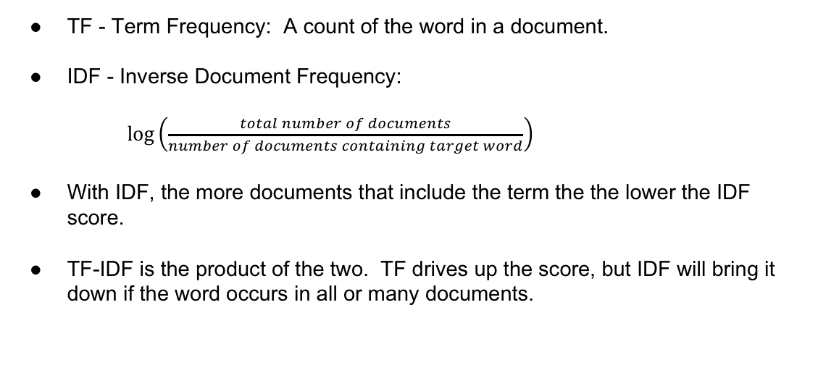
TF-IDF
A measure intended to reflect the importance of a word in a text.
TF - Term Frequency: A count of the word in a document.
IDF - Inverse Document Frequency:
$\log\left(\frac{total number of documents}{number of documents containing target word}\right)$
With IDF, the more documents that include the term the the lower the IDF score.
TF-IDF is the product of the two. TF drives up the score, but IDF will bring it down if the word occurs in all or many documents.

Slide 21
TF - Bag of Words
The methods used for term frequency use a “bag of words” approach.
Each document is represented by a “bag of words” where grammar and word order are disregarded but multiplicity is kept.

Slide 22
Finding TF: CountVectorizer
Convert a collection of text to vectors of token counts.
Three parameters:
minTF: Sets the minimum term frequency of a word. A value of 1 will ensure all words are included.
minDF: Sets the minimum document frequency of a word. A value of 1 will ensure all words are included.
vocabSize: Limits the size to the top number of words specified. A number greater than or equal to the number of unique words in the corpus will include all words.
The results will be returned in descending values and based on the the terms frequency across the entire corpus not just the document and will eliminate words based on parameters.

Slide 23
Finding TF: HashingTF
Hashing is the process of transforming data of arbitrary size to a fixed size.
Each word is input in a hash function to give it a number. The same words result in the same hash ID.
Each hash is counted returning the term frequency for each word.

Slide 24
The IDF Model
After using HashingTF or CountVectorizer to get term frequency TD-IDF can be calculated by fitting the features with a IDFModel.
The IDFModel scales each column based on feature vectors which decreases weights on words found in multiple documents.
Notes:
https://spark.apache.org/docs/2.1.0/ml-features.html#tf-idf

